Slide 1
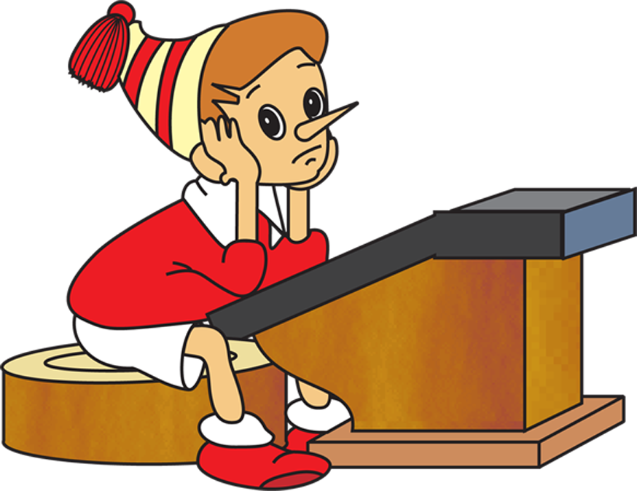
Intellectual Marathon

Slide 2
Categories
10
20
30
40
50
School
World
Time
Secret
10
20
30
40
50
10
20
30
40
50
10
20
30
40
50

Slide 3
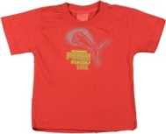
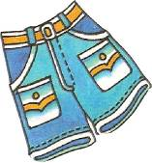
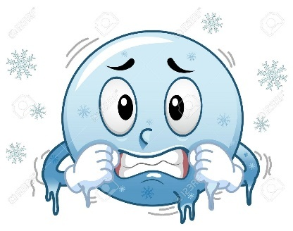
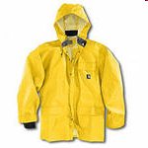
School. Give Names to the pictures and write them down.
10
1. I usually wear a red and blue in
2. When it is I put on my grey and my yellow

Slide 4
School. Give Names to the pictures and write them down.
10
I usually wear a red T-SHIRT and blue SHORTS in SUMMER.
When it is COLD I put on my grey SWEATER and my yellow JACKET

Slide 5
School. Write down 5 words, associated with school.
20
Teacher
School

Slide 6
School. Write down 5 words, associated with school.
20
ART
COUNT
Teacher
School
LESSON
TIMETABLE
ENGLISH

Slide 7
School. Find mistakes and write the correct form.
30
She go to school every day.
I like this boots.
What would you like?- I like this scarf.

Slide 8
School. Find mistakes and write the correct form.
30
She goES to school every day.
I like this THESE boots.
What would you like?- I WOULD like this scarf.

Slide 9
School. Read the transcription and write down the words
40
|ˈrʌʃ(ə)n|
|məeθs|
|ˈmjuːzɪk|

Slide 10
School. Read the transcription and write down the words
40
|ˈrʌʃ(ə)n| RUSSIAN
|məeθs|MATHS
|ˈmjuːzɪk|MUSIC

Slide 11
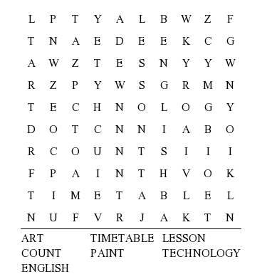
School. Find the words.
50

Slide 12
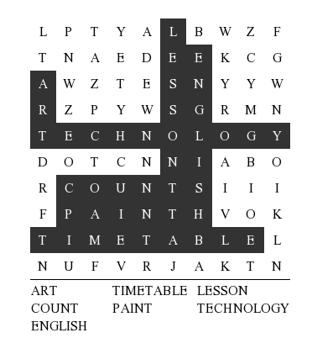
School. Find the words.
50

Slide 13
WORLD. What is the weather in Paris ?
10
wamr
dyclou
Paris

Slide 14
WORLD. What is the weather in Paris ?
10
WARM
CLOUDY
Paris

Slide 15
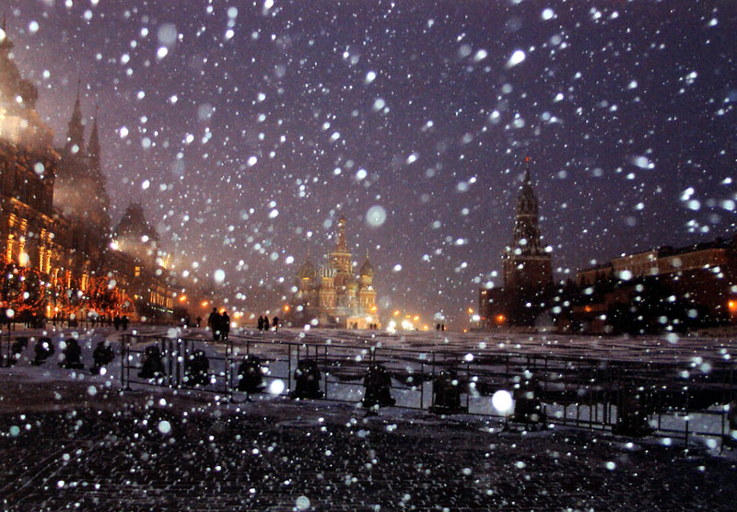
Nature. What is the weather in moscow?
10
ldco
wynos
Moscow

Slide 16
Nature. What is the weather in moscow?
10
COLD
SNOWY
Moscow

Slide 17
WORLD. Put days in the correct order.
20
Wednesday
Saturday
Monday
Friday
Tuesday

Slide 18
WORLD. Put days in the correct order.
20
Monday
Tuesday
Wednesday
Friday
Saturday

Slide 19
WORLD. Make the correct form.
30
1. Mike is ____(tall) than Liz.
2. This rose is_____ (beautiful) than that rose.
3. My teacher is ____ (good).

Slide 20
WORLD. Make the correct form.
30
1. Mike is TALLER than Liz.
2. This rose is MORE BEAUTIFUL than that rose.
3. My teacher is THE BEST.

Slide 21
WORLD. Read the transcription and write down words .
40
1. |hɔːl|
2. |ˈbɑːθruːm|
3. |haʊs|

Slide 22
WORLD. Read the transcription and write down words .
40
1. |hɔːl| HALL
2. |ˈbɑːθruːm|BATHROOM
3. |haʊs|HOUSE

Slide 23
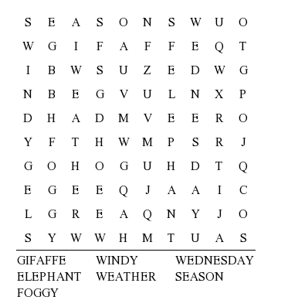
WORLD. Find the words .
50

Slide 24
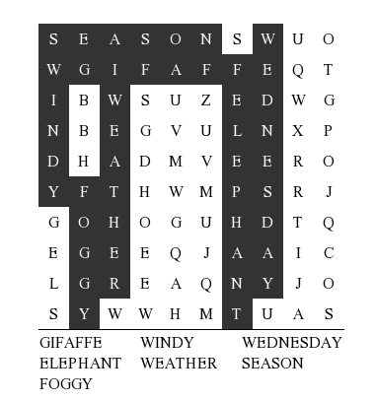
WORLD. Find the words .
50

Slide 25
Time. What time is it?
10
1.
2.

Slide 26
Time. What time is it?
10
1.
2.
IT’S THREE FIFTY FIVE
IT’S TWO TWENTY FIVE

Slide 27
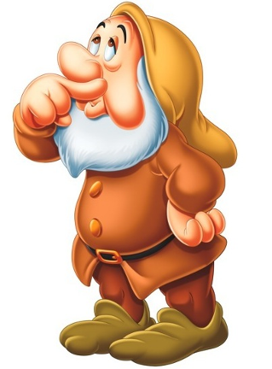
Time. Put numerals from the smallest to the biggest
20
fifty six ,
four,
twenty three,
nineteen,
twelve

Slide 28
Time. Put numerals from the smallest to the biggest
20
four,
twelve,
nineteen,
twenty three,
fifty six

Slide 29
Time. Make sentences .
30
do/morning/do/what/in/the/you?
get up/your/does/at/7 o’clock/mother?
bed/go/to/do/when/you/usually?

Slide 30
Time. Make sentences .
30
What do you do in the morning?
Does your mother get up at 7o’clock?
When do you usually go to bed?

Slide 31
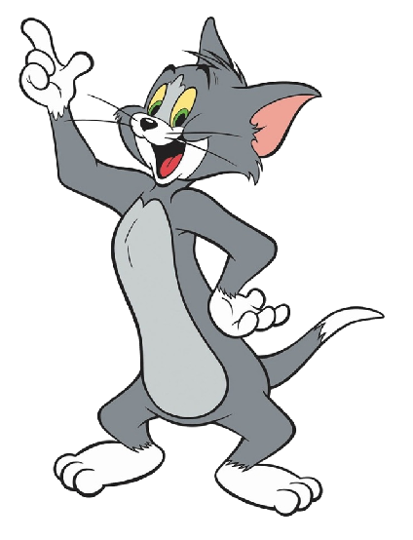
Time. Read transcription and write down words .
40
1. |ˈɡrəendəed|
2. |ˈtʃɪldrən|
3. |ˈmʌðə|

Slide 32
Time. Read transcription and write down words .
40
1. |ˈɡrəendəed| GRANDDAD
2. |ˈtʃɪldrən| CHILDREN
3. |ˈmʌðə| MOTHER

Slide 33
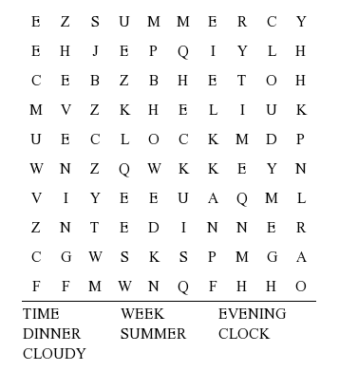
Time. Find words .
50

Slide 34
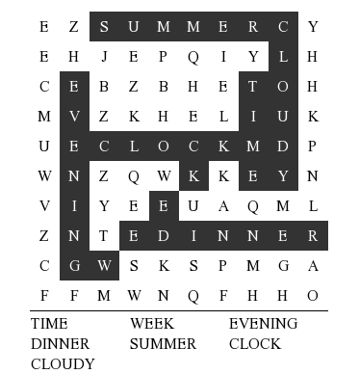
Time. Find words .
50

Slide 35
Secret. Musical pause .
10

Slide 36
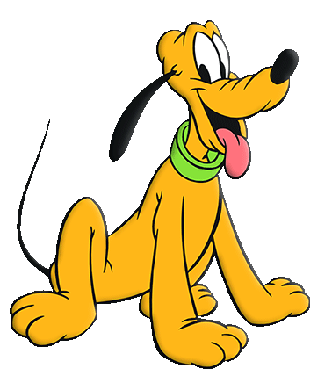
Secret. Name 5 members of the family.
20
SON
Family

Slide 37
Secret. Name 5 members of the family.
20
SISTER
SON
BROTHER
Family
MOTHER
FATHER
MOTHER

Slide 38
Secret. Tell the right words.
30
1. Mike is number 1. He is ____.
2. Liz is number 3. She is ____.
3. We are number 5. We are ____

Slide 39
Secret. Tell the right words.
30
1. Mike is number 1. He is THE FIRST.
2. Liz is number 3. She is THE THIRD.
3. We are number 5. We are THE FIFTH.

Slide 40
Secret. Read the transcription and write down the words.
40
|mjuːˈzɪəm|
|ˈsɪnəmə|
|ˈdɪskəʊ|

Slide 41
Secret. Read the transcription and write down the words.
40
|mjuːˈzɪəm| MUSEUM
|ˈsɪnəmə| CINEMA
|ˈdɪskəʊ| DISCO

Slide 42
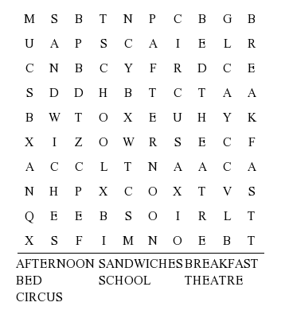
Secret. Find words.
50

Slide 43
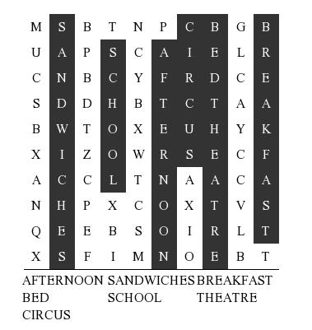
Secret. Find words.
50

